Slide 1
Smart Contract Risk Analysis
~ Prakhyati Bansal
Webacy Externship

Slide 2
Introduction
Objective: Provide insights into the frequency and correlation of smart contract vulnerabilities and propose actionable strategies to mitigate risks.
Scope: The analysis covers multiple risk tags and explores their relationships using the Phi coefficient.

Slide 3

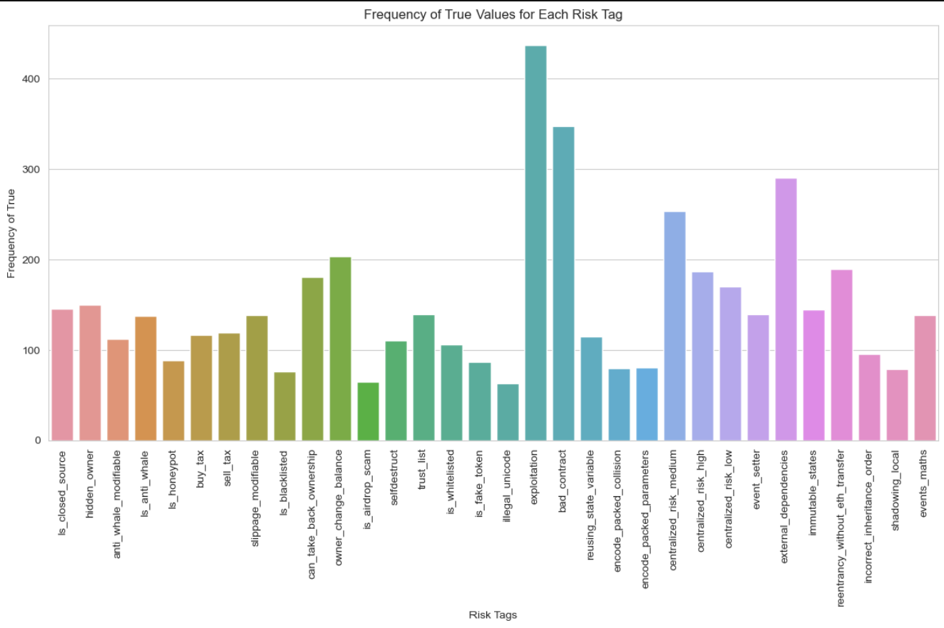
Key Vulnerabilities Identified
MOST FREQUENT RISK TAGS:
1. EXPLOITATION
2. BAD CONTRACT
3. EXTERNAL DEPENDENCIES
THESE TAGS HIGHLIGHT AREAS OF HIGH VULNERABILITY IN SMART CONTRACTS, PARTICULARLY RELATING TO CODE QUALITY, RELIANCE ON THIRD-PARTY SERVICES, AND SUSCEPTIBILITY TO ATTACKS.

Slide 4
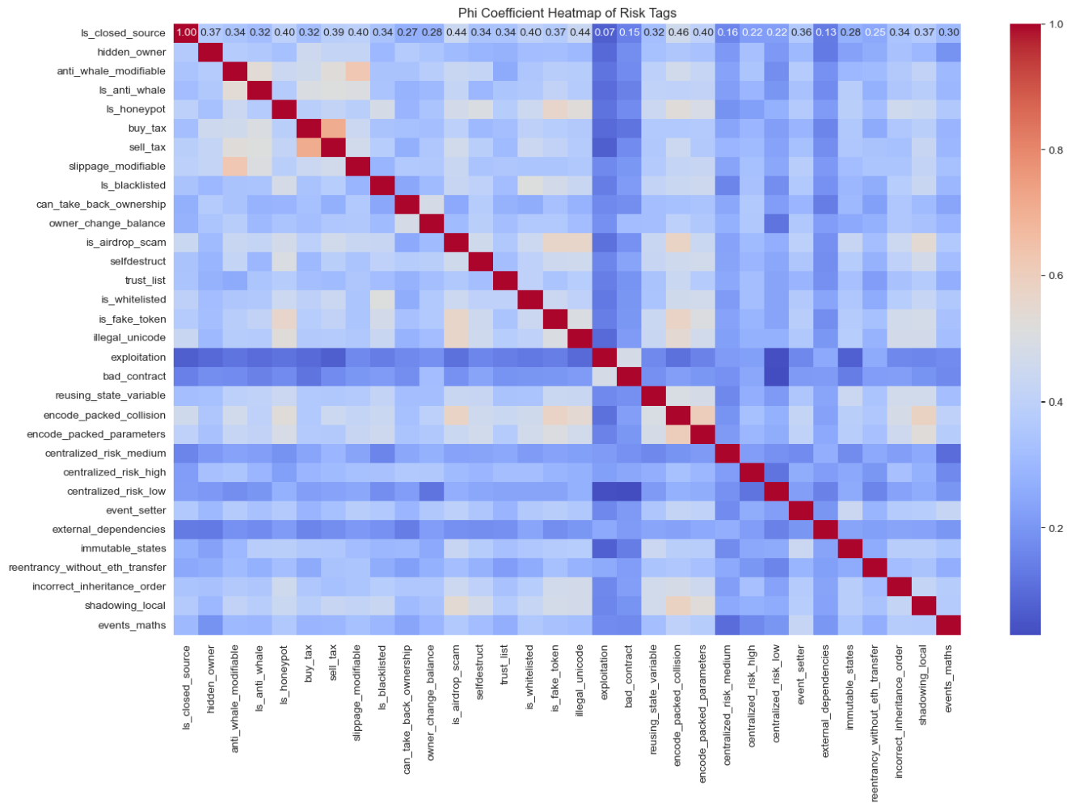
Risk tag correlation analysis
Correlated Pairs:
Buy Tax - Sell Tax: These settings are often modified together, affecting user transaction costs.
Slippage Modifiable - Anti-Whale Modifiable: Indicates a relationship between preventing market manipulation by whales and liquidity management features.

Slide 5
Strategic recommendations
1. Strengthen Exploitation Prevention:
Action: Implement regular external audits and static analysis tools to identify exploitable vulnerabilities in contract code.
Implementation: Automate code scanning tools during the development lifecycle to catch common issues early.
2. Address "Bad Contract" Issues:
Action: Establish a more robust internal review system and enforce code quality standards to avoid bad practices.
Implementation: Use peer-review models and enforce coding guidelines across teams.
3. Reduce Risks from External Dependencies:
Action: Rely on trusted external contracts and perform comprehensive due diligence when integrating third-party contracts.
Implementation: Isolate critical functions from external services and require thorough external contract audits before integration.
4. Monitor Transaction Fee Modifiability (Buy/Sell Tax):
Action: Set fixed thresholds for buy/sell tax and limit the ability of owners to modify transaction fees after contract deployment.
Implementation: Use governance frameworks to manage transaction fee modifications transparently.
5. Manage Slippage and Anti-Whale Features:
Action: Conduct regular reviews of liquidity settings to ensure that the slippage and whale-prevention mechanisms are functioning as intended.
Implementation: Implement automated alert systems to detect and prevent abusive changes to these settings.

Slide 6
REAL- WORLD IMPLEMENTATIONS
Blockchain Application Strategy:
Smart Contract Development: Prioritize frequent audits and reviews, focusing on the high-risk areas highlighted (e.g., exploitation, external dependencies).
Governance: Incorporate transparent governance structures that restrict the ability to modify critical contract settings such as transaction fees or slippage.
Automated Security Checks: Leverage blockchain tools that monitor live contracts for unusual activity (e.g., slippage changes, large withdrawals) to detect malicious behaviors early.

Slide 7
Conclusion
Takeaways:
Most frequent vulnerabilities ("exploitation," "bad contract") highlight a need for code quality control and security audits.
Correlated risks (buy/sell tax, slippage/anti-whale) require targeted oversight and restrictions on owner modifiability.
Strategic measures, including audits, automated checks, and governance models, can significantly improve the security and robustness of smart contracts in real-world applications.
Call to Action: Incorporate these insights into future development practices to strengthen the security posture of blockchain ecosystems.

